Slide 1
Software Quality Engineering (SQE)

Slide 2
Summary of the previous lecture
What is a software?
Characteristics of a Software
What is Engineering?
What is difference between engineering, manufacturing and construction
What is Quality?
What are the characteristics for high quality software?

Slide 3
Outlines
Meeting People’s Quality Expectations
General Expectations
Quality Expectations
Meeting Quality Expectations
Software Quality Engineering (SQE) activities

Slide 4
Objectives
To describe the basics of what is expected as quality
To understand and distinguish between people expectations and software quality expectations.

Slide 5
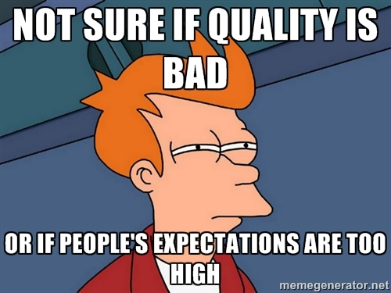
Meeting People’s Quality Expectations
Quality Expectations are associated to needs, goals, wishes and wants of peoples
General Expectations V/S Specific Expectations
Software must perform according its expected behavior as per its general and specified requirements
If people’s expectations are met in any sort of product, then, it is supposed to have quality in it

Slide 6
General V/S Specific Quality Expectations
Software could be understood as product/system/service
E.g. stand-alone to embedded software
E.g. highly intensive software systems
General expectation: i.e. “good” software quality
Specific quality expectation: deals with certain characteristics/properties of a software that make it a high quality software

Slide 7
Quality Expectations
People: Consumers vs producers .
quality expectations by consumers must be satisfied by producers through software quality engineering (SQE) activities, process, measures and standards
Deliver software system that....
does what it is supposed to do –
needs to be “validated”
does the things correctly
– needs to be “verified”
show/demonstrate/prove it (“does”) – modeling/analysis needed

Slide 8
Challenges in Meeting Quality Expectations
Challenges in achieving good quality software:
Requirements identification and analysis
Software Size
Software Complexity
Flexibility/Reusability
Adaptability
Resource constraints
Environmental stress
Other challenges in achieving good quality software:
Product type
Cost
Market conditions

Slide 9
Major SQE Activities
Major SQE Activities:
Quality planning
Execution of selected quality assurance techniques
Verification and Validation through testing
Measurement, Analysis and Modeling
Scope and content hierarchy:
Software Quality Engineering
Quality Assurance
Testing

Slide 10
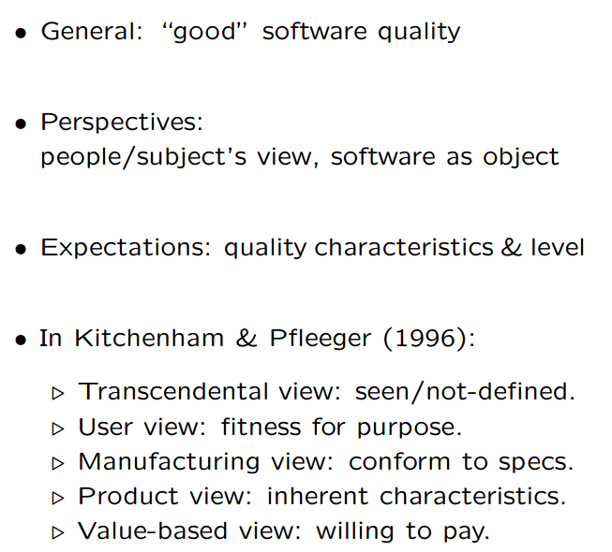
Perspectives and Expectations

Slide 11
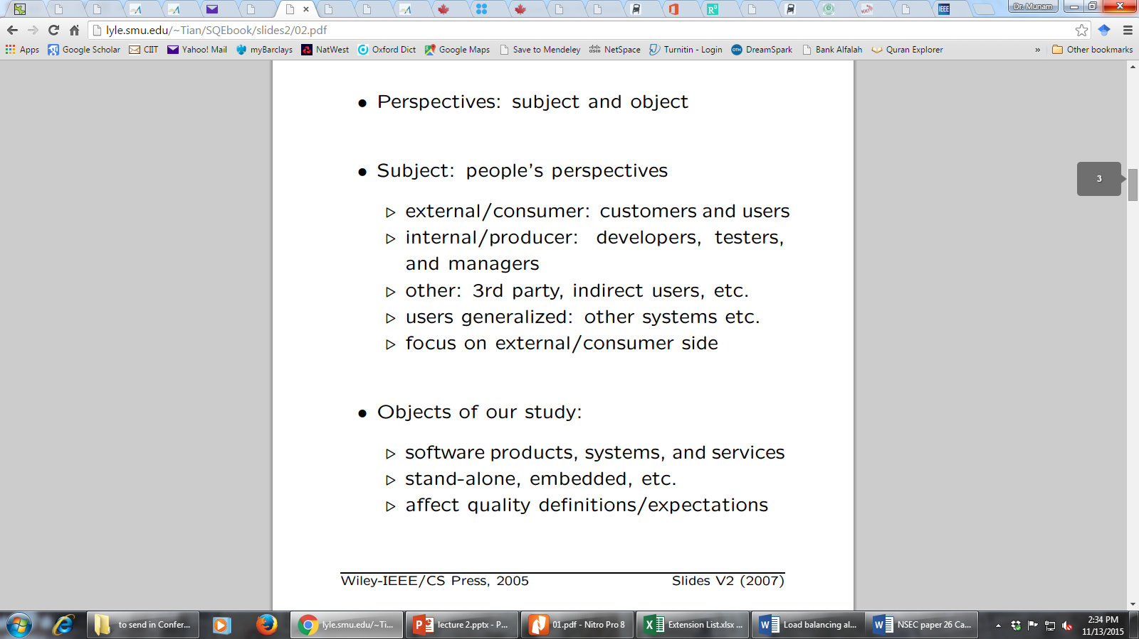
Quality Perspective

Slide 12
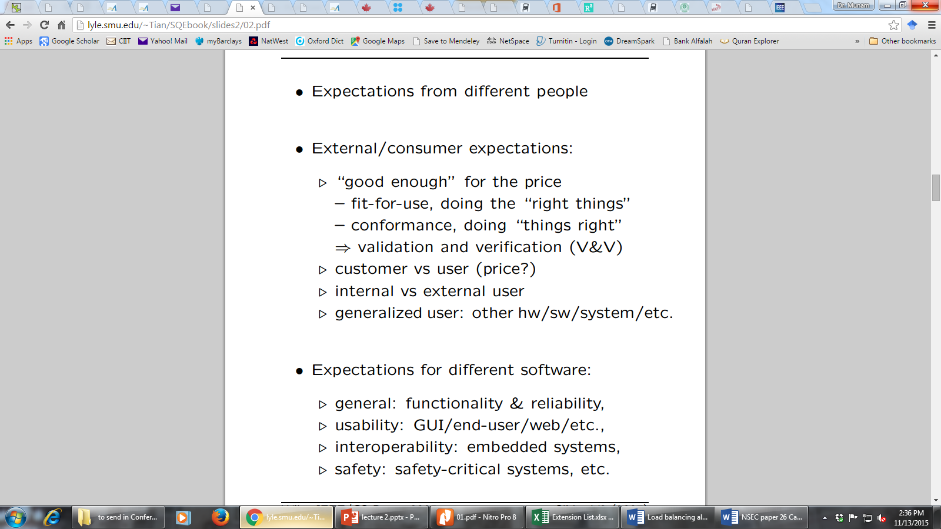
Quality Expectations

Slide 13
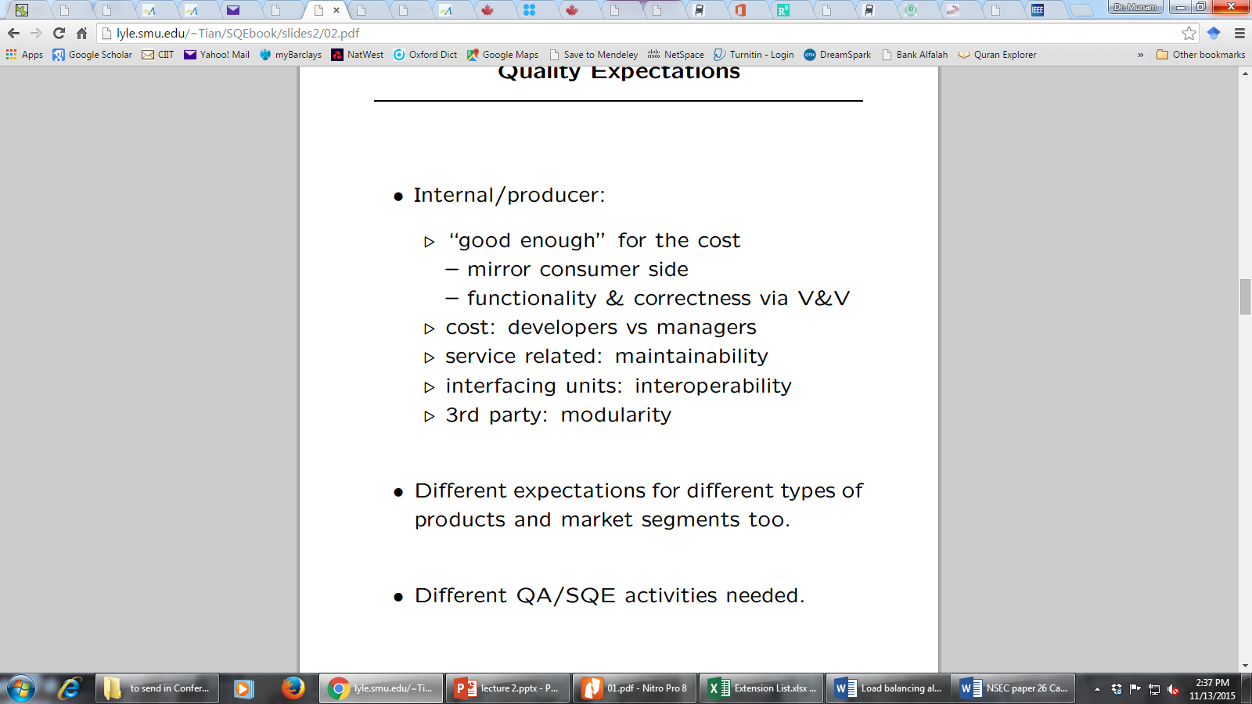
Quality Expectations (conti..)

Slide 14
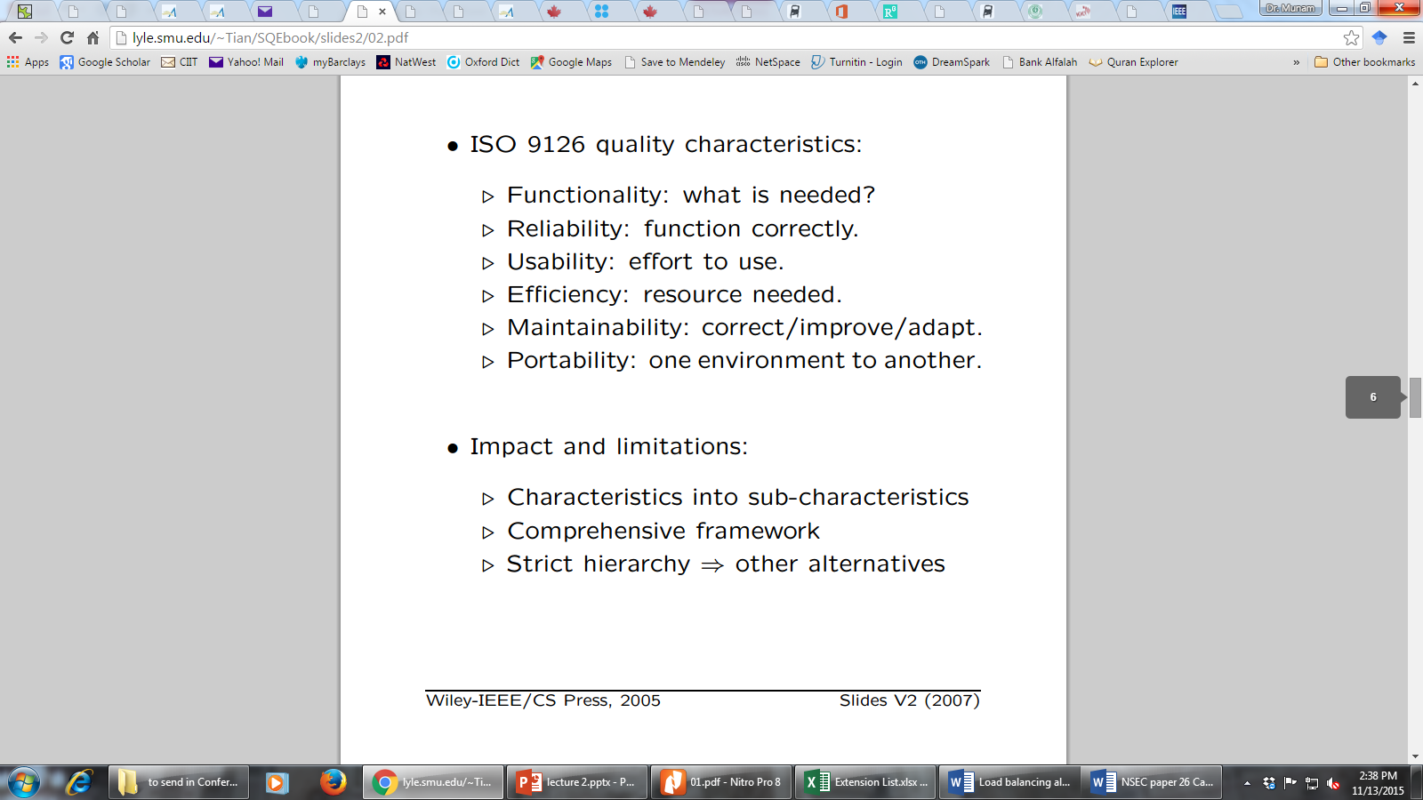
ISO-9126 Quality Framework

Slide 15
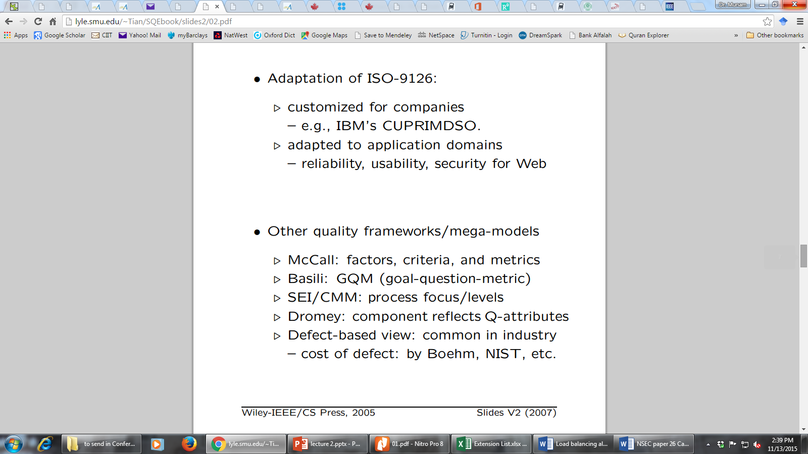
Other Quality Frameworks

Slide 16
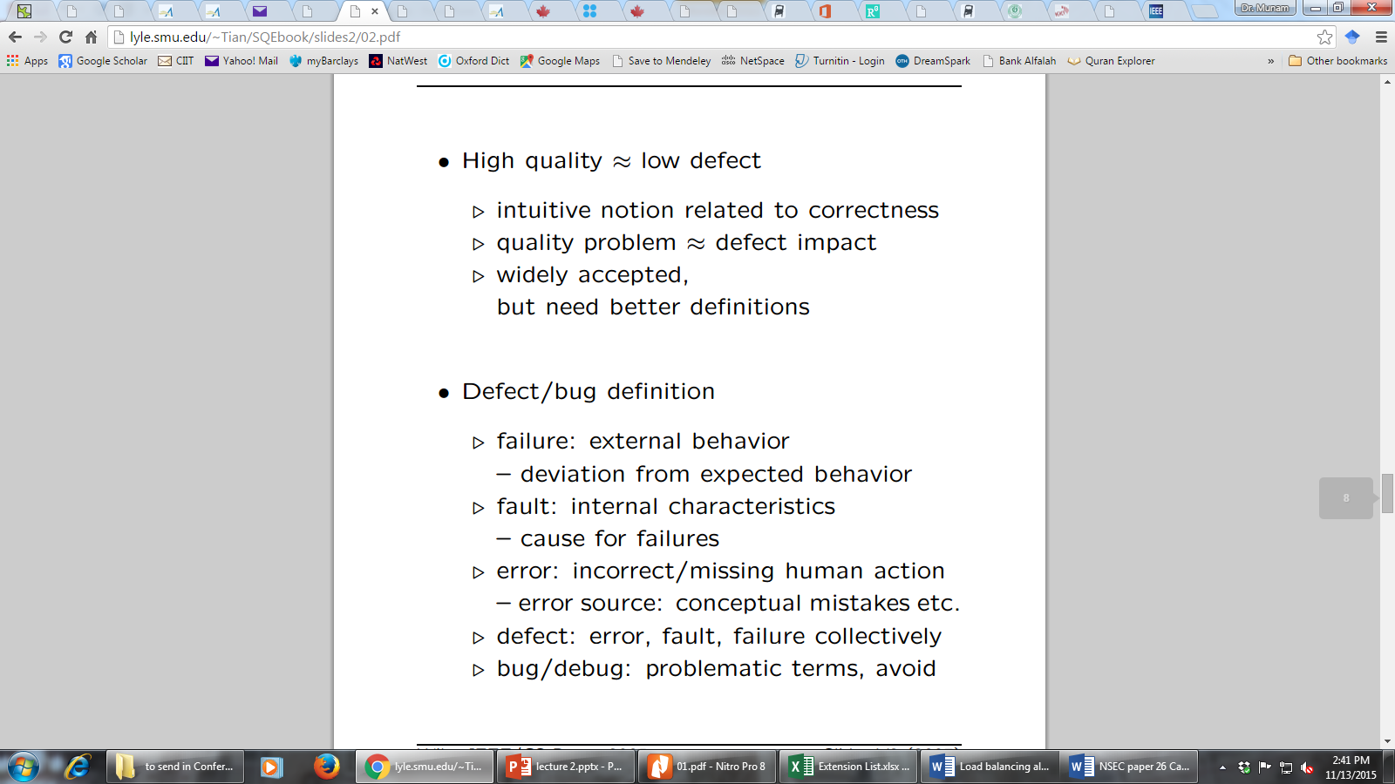
Correctness, Defect and Quality

Slide 17
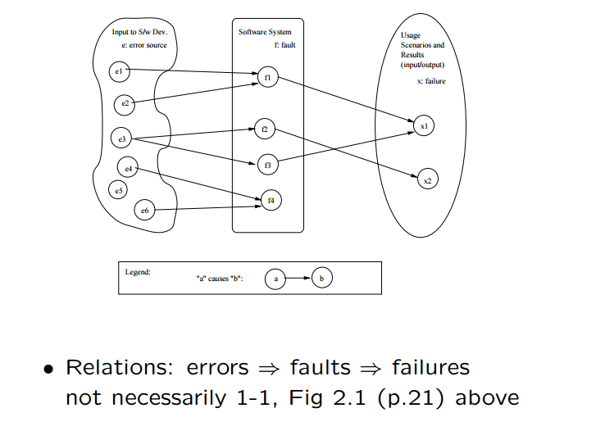
Correctness, Defect and Quality

Slide 18
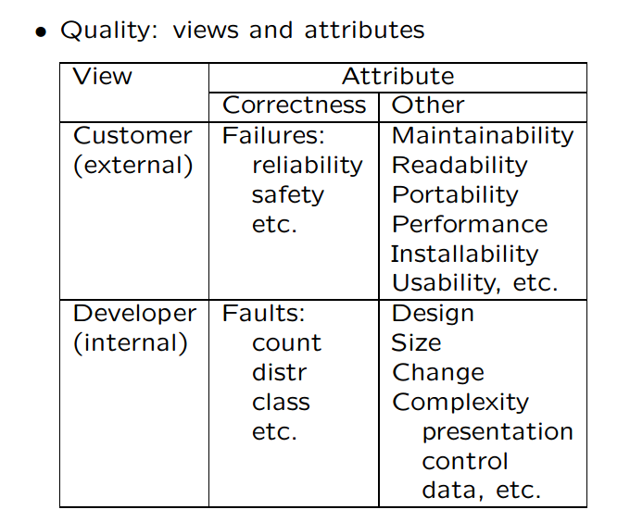
Defining Quality in SQE

Slide 19
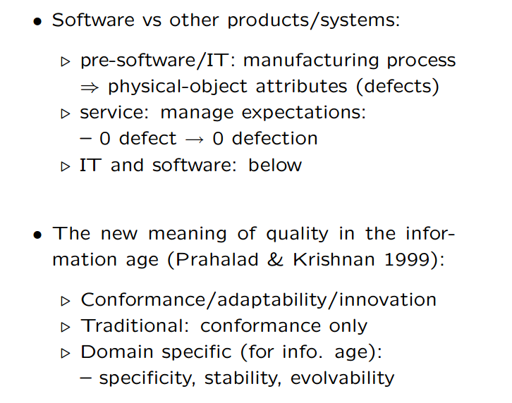
Quality: Historical Perspective

Slide 20
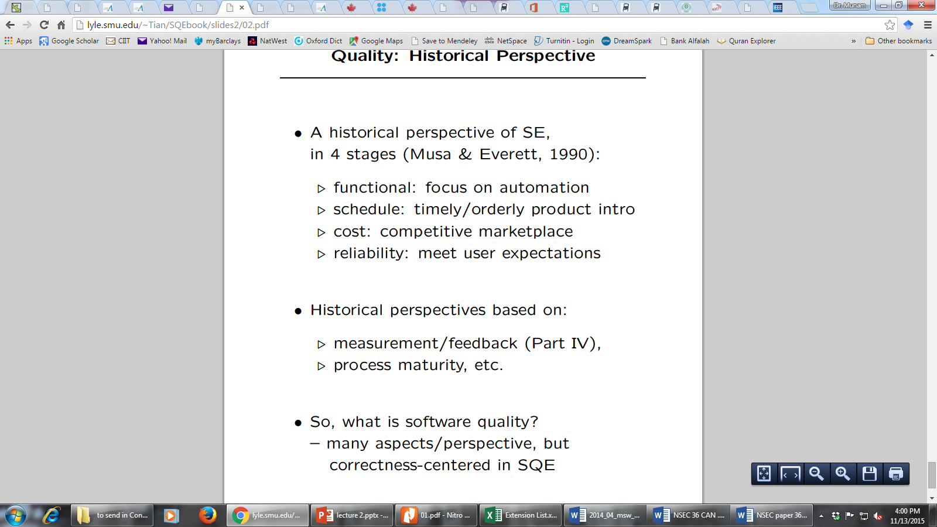
Quality: Historical Perspective (conti..)

Slide 21
Summary of Today’s Lecture
We explored the concept of quality from different aspects.
We have also seen what is a defect or failure to the quality.
Lastly, we talked about the history of the Quality

Slide 22
The End

